Slide 1
Hibernate - Advance
September 5, 2016

Slide 2
Collection Mapping
One to Many Mapping
One to One Mapping
Many to Many Mapping
Hibernate Cache
Few more topics
ColumnTransformer
@Formula
@Any
@Temporal
@Index
Locking
Interceptor Interface
Attribute Convertor
BasicTypeRegistry
Explicit BasicTypes
Transaction Isolation Level / Strategies

Slide 3
Objectives
Learning Advance hibernate topics including-
Collection Mapping
One to Many Mapping
One to One Mapping
Many to Many Mapping
Hibernate Cache

Slide 4
Collection Mapping

Slide 5




Collection Mapping Problem
We are working for an on line shopping site (lets suppose Tele Venture Marketing – TVM). For each item, TVM wants to put one or more images. With respect to JAVA programming, you would like to have a collection of images in your item POJO. But how this arrangement will be mapped to the database?
Image 1
Image 2
Image 3
Notes:
5

Slide 6
Set Property Mapping

Slide 7
Set of File name in POJO class
We have different implementations of set provided in java.util framework. If you were the hibernate designer you must have the issue of Set type mapping. Different type of sets have different functionality, even you can have user defined implementation of a set.
Either you would provide the flexibility to define the set type (which type of set) to the hibernate, or you will restrict the type of set in hibernate application.
Hibernate restricts the type of a Set in hibernate application. You can have a Set collection in a POJO by having the reference of following interfaces:
A java.util.Set is mapped with a <set> element. Initialize the collection with a java.util.HashSet. The order of its elements isn’t preserved, and duplicate elements aren’t allowed. This is the most common persistent collection in a typical Hibernate application.
A java.util.SortedSet can be mapped with <set>, and the sort attribute can be set to either a comparator or natural ordering for in-memory sorting. Initialize the collection with a java.util.TreeSet instance.
If you insert the item POJO first time to the database, you need to have a concrete implementation of Set to add your images. java.util.HeshSet is used to initialize the Set.
If you fetch, item entity from the database, hibernate provide its own implementation of set for the image collection.

Slide 8
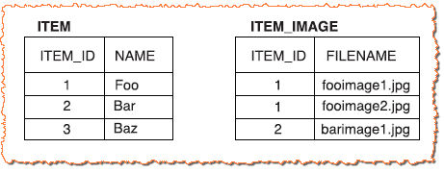
Set of File name in Database
From the point of view of the database, a new database table is maintained for the item images. ITEM_IMAGE table is a separate entity, a separate table, but Hibernate hides this for you.
ITEM_IMAGE table maintains an ITEM_ID column referencing ITEM table primary key.
A set can’t contain duplicate elements, so the primary key of the ITEM_IMAGE collection table is a composite of both columns in the <set> declaration: ITEM_ID and FILENAME.

Slide 9
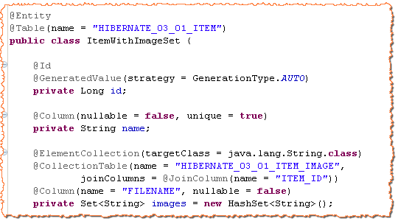
Set Mapping Example
Item POJO
Collection of String
Collection table with join column name
Column name for images

Slide 10
Exercise
Create a database BookStoreDB. Create a simple java project named BookStoreApp.
Create a Hibernate/JPA POJO Book with fields ISBN number, book title and publication date.
Every book has a set of author names. An author of a book is not an entity in our book store application.
Map this arrangement in hibernate using set.

Slide 11
Bag Property Mapping

Slide 12
Bag of File name in POJO class
An unordered collection that permits duplicate elements is called a bag.
Java Collections framework doesn’t include a bag implementation. However, the java.util.Collection interface has bag semantics.
You can use either java.util.Collection reference or java.util.List reference for a bag mapping. Reference of List interface for a bag isn’t recommended, because clients using this collection property may think the order of elements is always preserved, which isn’t the case if it’s mapped as a bag.
java.util.ArrayList is used to initialize the collection,

Slide 13
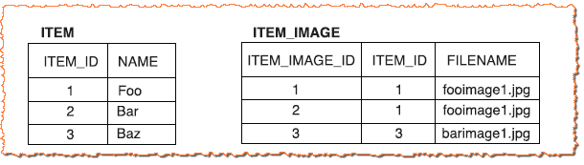
Bag of File name in Database
From the point of view of the database, a new database table is maintained for the item images. ITEM_IMAGE table is a separate entity, a separate table, but Hibernate hides this for you.
ITEM_IMAGE table maintains an ITEM_ID column referencing ITEM table primary key.
ITEM_IMAGE table has its own surrogate key in order to allow duplicate values.

Slide 14
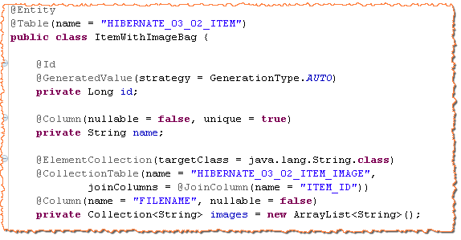
Bag Mapping Example
Item POJO
Collection of String
Collection table with join column name
Column name for images
java.util.Collection

Slide 15
Exercise
Create a database BookStoreDB. Create a simple java project named BookStoreApp.
Create a Hibernate/JPA POJO Book with fields ISBN number, book title and publication date.
Every book has an unordered list of images.
Map this arrangement in hibernate using bag.

Slide 16
Indexed List Property Mapping

Slide 17
Indexed List of File name in POJO class
An ordered collection that permits duplicate elements is called a indexed List.
java.util.List reference is used for a indexed list mapping.
java.util.ArrayList is used to initialize the collection,

Slide 18
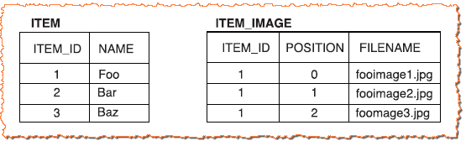
Indexed List of File name in Database
From the point of view of the database, a new database table is maintained for the item images. ITEM_IMAGE table is a separate entity, a separate table, but Hibernate hides this for you.
ITEM_IMAGE table maintains an ITEM_ID column referencing ITEM table primary key.
A list mapping requires the addition of an index column to the collection table. The index column defines the position of the element in the collection. Thus, Hibernate is able to preserve the ordering of the collection elements.
The primary key of the collection table is a composite of ITEM_ID and indexed column..

Slide 19
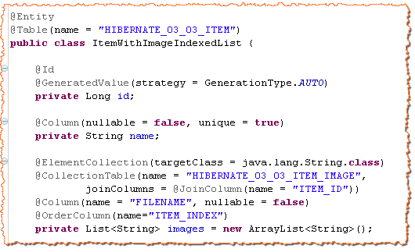
Indexed List Mapping Example
Item POJO
Collection of String
Collection table with join column name
Column name for images
Indexed Column
java.util.List

Slide 20
Exercise
Create a database BookStoreDB. Create a simple java project named BookStoreApp.
Create a Hibernate/JPA POJO Book with fields ISBN number, book title and publication date.
Every book has an ordered index of chapters.
Map this arrangement in hibernate using indexed list.

Slide 21
Map Property Mapping

Slide 22
A Map of File name in POJO class
An unordered collection for key value pair that does not permit duplicate key is called a Map.
java.util.Map or java.util.SortedMap reference is used for a Map property mapping.
java.util.HashMap or java.util.TreeMap is used to initialize the collection,

Slide 23
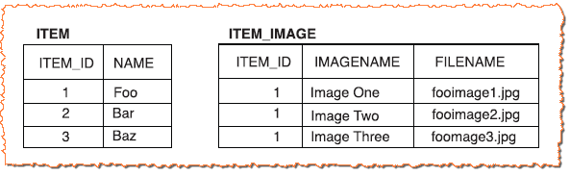
A Map of File name in Database
From the point of view of the database, a new database table is maintained for the item images. ITEM_IMAGE table is a separate entity, a separate table, but Hibernate hides this for you.
ITEM_IMAGE table maintains an ITEM_ID column referencing ITEM table primary key.
A map mapping requires the addition of an map key column to the collection table.
The primary key of the collection table is a composite of ITEM_ID and map key column. The IMAGENAME column holds the keys of the map.

Slide 24
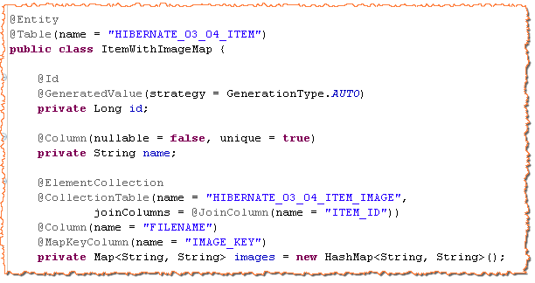
A Map property Mapping Example
Item POJO
Collection table with join column name
Column name for images
Map key Column
java.util.Map

Slide 25
Exercise
Create a database BookStoreDB. Create a simple java project named BookStoreApp.
Create a Hibernate/JPA POJO Book with fields ISBN number, book title and publication date.
Every chapters has one or more images.
Map this arrangement in hibernate using map. Key of the map should be the name of the chapter.

Slide 26
Collection of Components

Slide 27
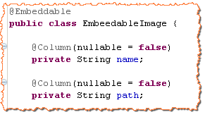
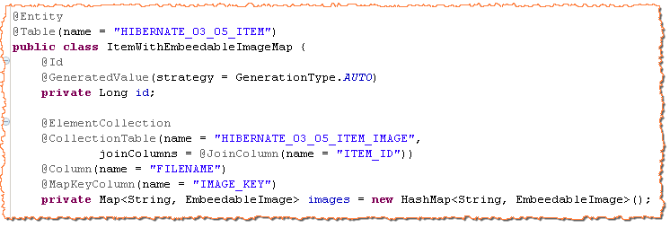
Object Collection property in POJO class
Collection strategies for the collection of object remains same as discussed earlier.
You can have a collection of embeddable POJO in your container pojo.

Slide 28
Exercise
Create a database BookStoreDB. Create a simple java project named BookStoreApp.
Create a Hibernate/JPA POJO Book with fields ISBN number, book title and publication date.
Every book has an ordered index of chapters and every chapter is started with an image.
Map this arrangement in hibernate using indexed list of Chapter objects.

Slide 29
Entity Association

Slide 30
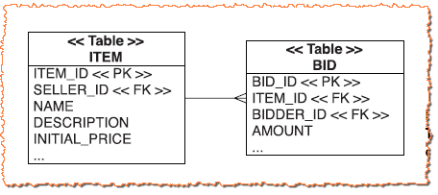
Database Entity Relationship
Database entities are related to each other by defining referential integrity. For example, an Item in an on line shopping can have more that one bids. Item and bids have one to many relationship and this relation ship is maintained as follows in a relational database:

Slide 31
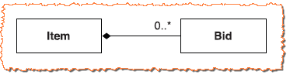
POJO relationship
With respect to JAVA programming, If an Item has one to many relationship with bid, you would like to have a collection of bid objects in item object and item object in all bid objects.
If you were a ORM developer, you will have to define a strategy of mapping between object association and entity relationship.
Hibernate, as well as JPA, defines so many techniques for association–relationship mapping.

Slide 32
One to Many Association Mapping

Slide 33
Problem Statement
In an on line shopping application, an item has one to many relationship with bids. You need to define this association of item to bid in POJO and you need to map this association to database entity relationship.
?
If a bid is added to Item Object
A Bid entity, referring item, should be created

Slide 34
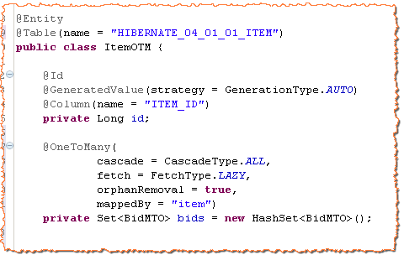
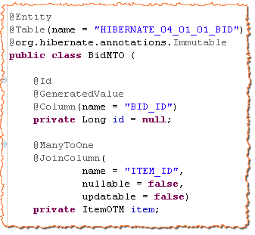
Lets have a look on code first
Set of Bids in Item Class
Item in Bid Class
Foreign Key Column

Slide 35
One Item is associated with many bids
@javax.persistence.OneToMany annotation needs to apply on the set of the bids in Item POJO.
@javax.persistence.ManyToOne annotation needs to apply on the item property in Bid POJO.
You need to define @javax.persistence.JoinColumn at item property in Bid POJO (Bid id has ITEM_ID column, a reference of Item entity).
Either, you need to @javax.persistence.JoinColumn at set of bids in Item POJO or you need to define mappedBy attribute of @javax.persistence.OneToMany annotation.

Slide 36
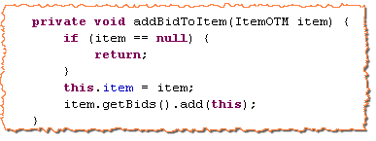
No Dirty checking for association
If your application need one to many bidirectional relationship between item and bid, you need to update this information in both the POJO objects at JVM level i.e. If a bid is added to the item set, item should also be set on the bid object.
If you want to add a bid to an item, you should call below method of Bid POJO.
Hibernate doesn’t manage persistent associations. If you want to manipulate an association, you must write exactly the same code you would write without Hibernate. If an association is bidirectional, both sides of the relationship must be considered.

Slide 37
Problem with bidirectional mapping
In the above code, we have added a bid to an item and item was set to the bid object. At runtime, there are two different in-memory representations of the same foreign key value: the item property of Bid and an element of the bids collection held by an Item.
In persistence context, both (item and bid) objects have been changed. Any change in the persistence context is propagated to the database.
In persistence context, Bid object is added and item object is updated. From the point of view of database, it is a single change.
Hibernate doesn’t transparently detect the fact that the two changes refer to the same database column. Hibernate find that 2 objects in persistence context has been updated.

Slide 38
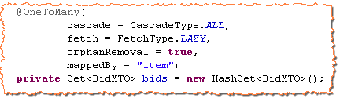
Hey Hibernate! It’s a single database change.
By specifying mappedBy attribute, you explicitly tell Hibernate which end of the link it should not synchronize with the database. In above example, you tell Hibernate that it should propagate changes made at the Bid end of the association to the database, ignoring changes made only to the bids collection.
@ManyToOne annotation does not have mappedBy attribute. So for one to many relationship, you can stop the change made at the item end to be propagated to the database.
Item property in Bid POJO

Slide 39
Cascading Object State

Slide 40
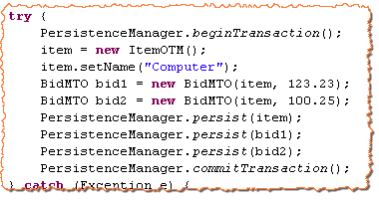
Would you like to persist all bids individually???
In our online shopping application, if you want to add two bids to an item, you will have to write below piece of code
Don’t you think that every bid should not be persisted programmatically? If we add bids to a persisted item, bids should be persisted automatically.
You have to persist each bid individually

Slide 41
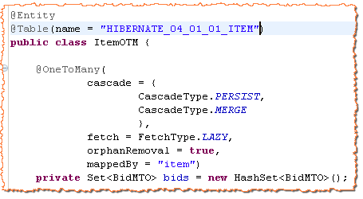
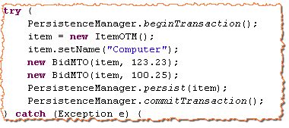
Persistence By Reachability
Hibernate support PERSIST and MERGE cascade type at association relationship. If you define PARSIST cascade type on set of bids, all the bids of an item are persisted when the item is persisted.
Cascade Operation at One to Many end
No Need to persist individual bids

Slide 42
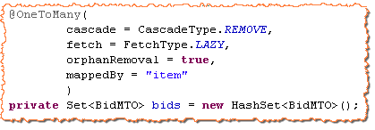
Cascade Delete
In our online shopping application, if an item is deleted from the database, all the bids should also be deleted from the database. Either you delete all related bids one by one (You are responsible ) from the database or you can set the cascade attribute to delete (Hibernate is responsible).
Hibernate delete all the bids by executing delete statements. Hibernate does not use database cascade functionality.
If Item is deleted,
All bids are deleted

Slide 43
Orphan Removal
If you delete a bid, not item, the bid object should be removed from the set of bids in item object. Either you will remove the deleted bid programmatically or you can set orphanRemoval attribute value to true.
If you delete a bid, bid will also be removed from list

Slide 44
Fetching strategies

Slide 45
Fetching Issue
If you fetch an item entity from database, bids on this items should also be fetched from the database otherwise getBids() method of Item class will return a null value or empty collection.
If you were a hibernate developer, would you like to leave this responsibility for the java programmer to fetch child entities programmatically? Of course No.
If a hibernate user fetch item entity from the database, he/she should not be worried about fetching bids of the item. Bids should be fetched by the hibernate framework either at the time of fetching item or lazily.

Slide 46
Lazy Fetching
Hibernate defaults to a lazy fetching strategy for all entities and collections. This means that Hibernate by default loads only the objects you’re querying for. Dependent entities are loaded when they are used lazily.
List of bids will be fetched lazily.

Slide 47
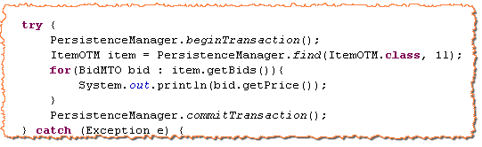
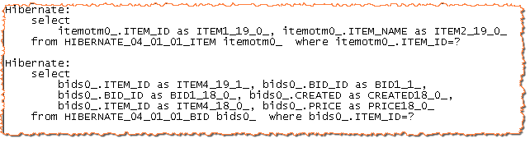
Lazy Fetching in Practice
List of bids is fetched at this point lazily.

Slide 48
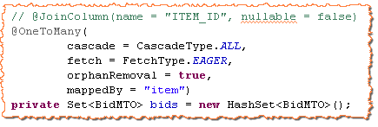
Eager Fetching
you often want to specify that a particular entity association or collection should always be loaded. You want the guarantee that this data is available in memory without an additional database hit. You can define the fetching strategy as eager.
List of bids will be fetched eagerly.

Slide 49
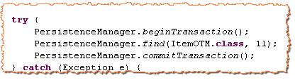
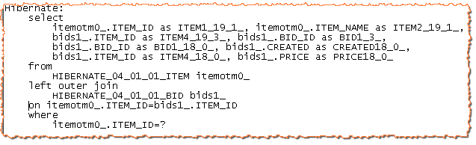
Eager Fetching in Practice
List of bids is fetched at this point eagerly.
Left Outer Join.

Slide 50

Exercise
Create a POJO class BookOrder that has a one to many relationship with Book class. It stores other information like order date, price, order state and set of books ordered.
Implement this association relationship by Hibernate/JPA.
Use cascading operation while persist.
Try it with different fetching strategies.

Slide 51
One to Many Association Using Map

Slide 52
Map in place of set
In our on line shopping application, an item can have more than one images. For bidirectional relationship, we wants to have a map (<String, Image>) in Item class.
We define @MapKey annotation on image map. Map key is stored in image table.

Slide 53
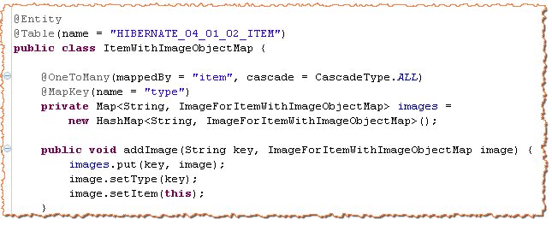
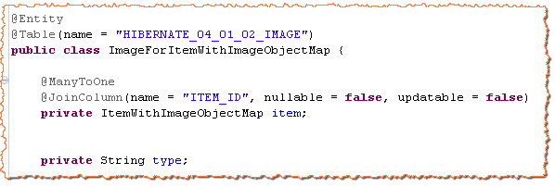
Set image type to the key of map
Map Key is stored in Image table

Slide 54
Exercise
Create a POJO class BookOrder that has a one to many relationship with Book class. It stores other information like order date, price, order state and set of books ordered.
Implement this association relationship by Hibernate/JPA using book name as the map key.

Slide 55
One to Many Unidirectional Indexed Association

Slide 56
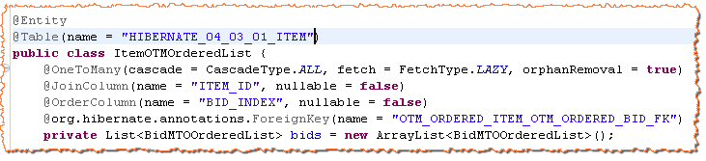
Maintain index order of bid
In our on line shopping application, an item can have more than one bids. For unidirectional relationship, we can have an indexed list of bids in Item class as follows:

Slide 57
One to Many Bidirectional Indexed Association

Slide 58
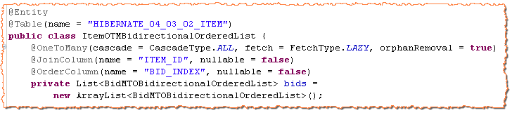
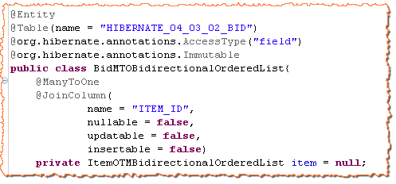
Maintain index order of bid
In our on line shopping application, an item can have more than one bids. For bidirectional relationship, we can have an indexed list of bids in Item class as follows:
No mappedBy attribute. Collection information is required to update the index
Equivalent to mappedBy, Updatable and insertable attributes are false.

Slide 59
One to One Association Using Same Primary Key

Slide 60
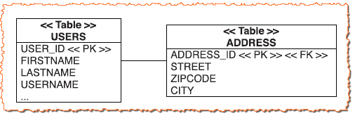
One User has one shipping address
In our on line shopping application, a user can be mapped to a single shipping address. We can have bidirectional one to one mapping between user and address.
We will have a one to one relation if Address table primary key references User table primary key.

Slide 61
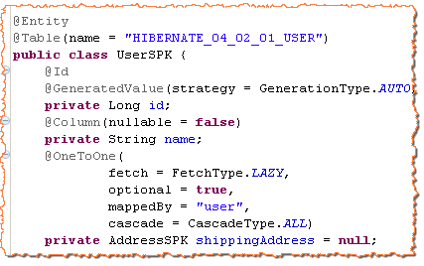
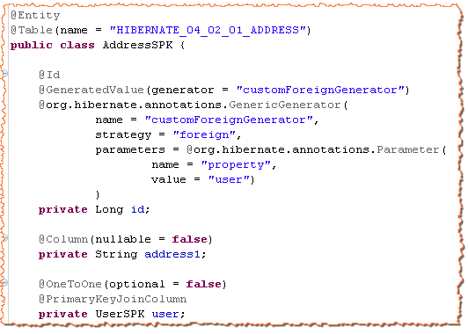
@OneToOne
Optional must be true
Foreign Key Generator
@OneToOne
@PrimaryKeyJoinColumn

Slide 62
Exercise
Create a POJO class Book that has a one to one relationship with cover image class.
Implement this association relationship by Hibernate/JPA same primary key approach.

Slide 63
One to One Association Using Unique Foreign Key

Slide 64
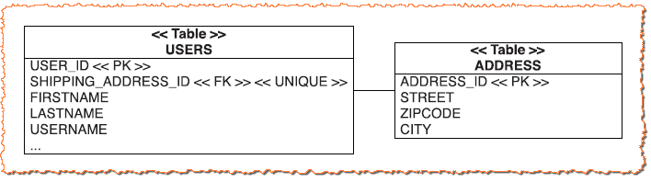
One User has one shipping address
Instead of sharing a primary key, two rows can have a foreign key relationship. One table has a unique foreign key column that references the primary key of the associated table.

Slide 65
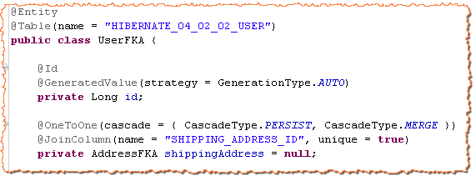
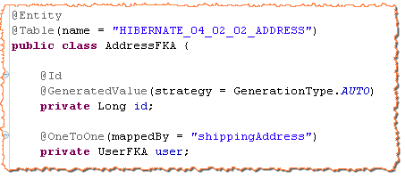
@OneToOne
Address key is unique
mappedBy at Address end
@OneToOne

Slide 66
Exercise
Create a POJO class Book that has a one to one relationship with cover image class.
Implement this association relationship by Hibernate/JPA same unique foreign key approach.

Slide 67
Many to Many Unidirectional Association

Slide 68
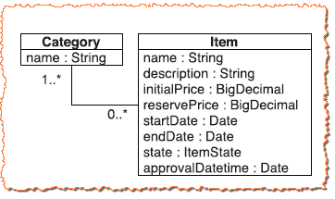
Many to Many relationship of Item and Category
In our on line shopping application, an item can be categorized in more than one category and a category can have more than one item.

Slide 69
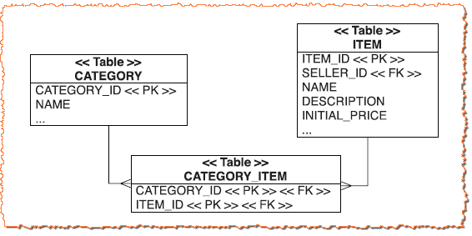
Many to Many relationship in database
Many to many relationship is maintained with the help of a join table. The join table (or link table, as some developers call it) has two columns: the foreign keys of the CATEGORY and ITEM tables. The primary key is a composite of both columns.

Slide 70
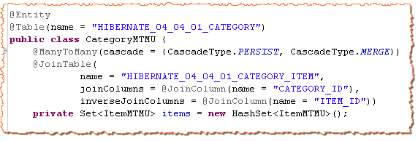
Many to Many Unidirectional POJO mapping
Join table with many to many relationship

Slide 71
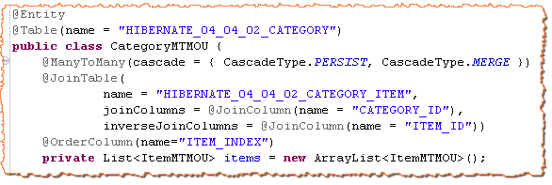
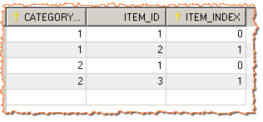

Many to Many Indexed Collection
Join table with many to many relationship
Order Column
Join table with category id and item index as primary key

Slide 72
Exercise
Create a POJO class Book that has a many to many relationship with Book Categories. We can fetch books of one category but we can not fetch categories of a book.
Implement this association relationship by Hibernate/JPA.

Slide 73
Many to Many Bidirectional Association

Slide 74
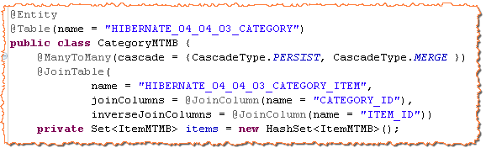
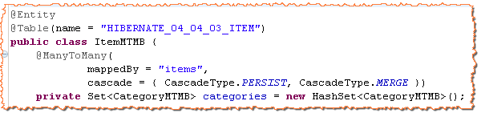
Many to Many Bidirectional POJO mapping
Join table with many to many relationship
mappedBy Attribute is required at other side

Slide 75
Exercise
Create a POJO class Book that has a many to many relationship with Book Categories. We can fetch books of one category and vice-versa.
Implement this association relationship by Hibernate/JPA.

Slide 76
The object-retrieval options
At this point, we have enough knowledge to store a JVM POJO to the database. Saving some data to the database is of no use if we do not fetch it. Database provide SQL queries to fetch database tables.
With respect to hibernate, we should have some mechanism to fetch the data from the database. Retrieving persistent objects from the database is one of the most interesting parts of working with Hibernate.
Hibernate provides the following ways to get objects out of the database:
Navigating the object graph
Retrieval by identifier
The Hibernate Criteria interface
The Hibernate Query Language / JPA Query Language
Native SQL queries
Navigating the object graph, starting from already loaded objects. If an object is in the persistence context, its associations also fetched in the persistence context. For example, if you fetch an item object in a persistence context, all it’s bids are also fetched in the same persistence context.

Slide 77
Retrieval By Identifier

Slide 78

Different Strategies for ID retrieval
Let us suppose we have a person entity in a database and we want to fetch a person object by providing identifier value. To retrieve a person entity by the identifier, we can call either of the two JPA method:
If getReference() can’t find the object in the cache or database, an unchecked exception EntityNotFoundException is thrown. The getReference() method never returns null. The find() method returns null if the object can’t be found.
The getReference() method may return a proxy instead of a real persistent instance. A proxy is a placeholder that triggers the loading of the real object when it’s accessed for the first time. On the other hand, find() never returns a proxy. find() method either hit the database or take the object from cache.
Hibernate get method is called
Hibernate load method is called.

Slide 79
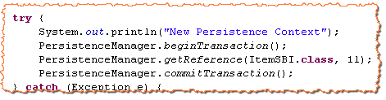
Understanding Proxies
Look at the below code snippet
We have used getReference() method to have the reference of an item entity with item_id 1. When we execute above program, no select query is executed. Hibernate generates a proxy of item object (Usually a subclass of Item overriding access methods) at runtime.

Slide 80
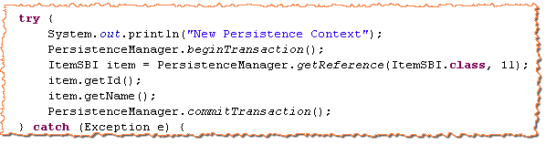
Proxy Initialization with real entity
A proxy object is initialized with real entity when it is accessed for first time.
If identifier has not been mapped with the field access, as long as you access only the database identifier property, no initialization of the proxy is necessary.
When you define a collection for lazily fetched, a proxy of collection is created at runtime. A collection is initialized if you start iterating through its elements or if you call any of the collection-management operations, such as size() and contains().
Entity is fetched here if identifier is field accessed
Entity is fetched here if identifier is not field accessed

Slide 81
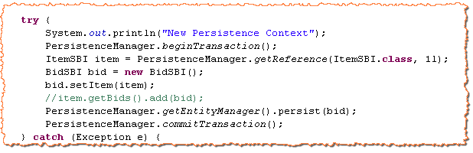
Need of a Proxy
In our on line shopping application, lets suppose that you want to just add a bid to the existing item and closing the persistence context.
Do you agree that item object should be fetched from the database while only bid entity is to be persisted to the database? Required item id for bid association has been given to the getReference() method.
We should have only one insert statement:
Need to have the reference of Item
No need to add bids to item. Transaction is over.

Slide 82
Problem with Proxy

Slide 83
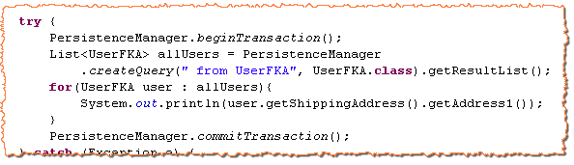
Un necessary database fetch
Let us suppose that shipping address of user is lazily fetched from the database. An application administrator wants to fetch a list of all users and then send a letter to corresponding shipping address.
Hibernate lazily fetch address object for each item in a separate database call.
Hibernate offers an optimization named: Batch Fetching or blind-guess-optimization.

Slide 84

Fill a batch of proxies
If one proxy of address must be initialized, let hibernate initialize more than one address proxies in a single select.
You are telling hibernate to pre-fetch up to 10 uninitialized proxies in a single SQL select, if a single proxy is initialized.
The resulting query is looks like below:
Select a.* from AddressFKA a where a.id in (?,?,?)
JPA do not provide batch optimization

Slide 85
Hibernate Cache

Slide 86
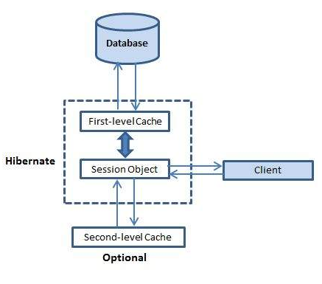
Caching is all about application performance optimization and it sits between your application and the database to avoid the number of database hits as many as possible to give a better performance for performance critical applications.

Slide 87
First level cache - L1 Cache
The first-level cache is the Session cache and is a mandatory cache through which all requests must pass. The Session object keeps an object under its own power before committing it to the database.
The L1 cache is connected directly to the Hibernate Session, ie the L1 cache runs throughout the lifecycle of the Session object, thus "born" and "die" with him. Because the L1 cache is internal to a Session object, it can not be accessed from other Sessions created by the Session Factory. Read more: http://mrbool.com/understanding-the-hibernate-cache-l1-and-l2-in-detail/33437#ixzz4JMixHlSM

Slide 88
Second level cache – L2 Cache
Second level cache is an optional cache and first-level cache will always be consulted before any attempt is made to locate an object in the second-level cache. The second-level cache can be configured on a per-class and per-collection basis and mainly responsible for caching objects across sessions.
Second level cache is created in session factory scope and is available to be used in all sessions which are created using that particular session factory. It also means that once session factory is closed, all cache associated with it die and cache manager also closed down.
Note-
Fist level cache Is is enabled by default and works in session scope.
Second level cache is apart from first level cache which is available to be used globally in session factory scope.
Read more: http://howtodoinjava.com/hibernate/how-hibernate-second-level-cache-works/

Slide 89
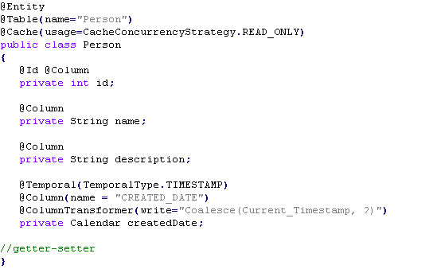
Configuring L2 Cache
1.) Add the mapping element required to tell Hibernate to cache Employee instances using READ_ONLY strategy.
Different strategies-
Read Only: This caching strategy should be used for persistent objects that will always
read but never updated.
Read Write: It’s good for persistent objects that can be updated by the hibernate application.
Nonrestricted Read Write: If the application only occasionally needs to update data and strict transaction isolation is not required, a nonstrict-read-write cache might be appropriate.
Transactional: The transactional cache strategy provides support for fully transactional cache providers such as JBoss TreeCache.

Slide 90

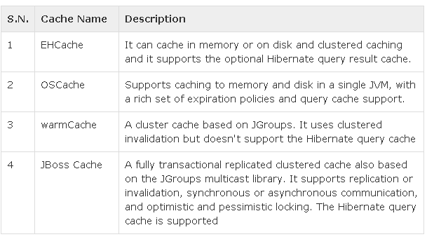
2.) Add provider class in hibernate configuration file-

Slide 91

3.) Create xml file called ehcache.xml and store in at class path location
[ no confusions, the place where you have mapping and configuration XML’s ] in web application.

Slide 92
Few More Topics

Slide 93

ColumnTransformer Annotation
Annotation org.hibernate.annotations.ColumnTransformer can be used to specify custom SQL during a write/update operation.
Suppose there is a requirement to have two columns - created_date and updated_date in Persontable.
created_date should be filled automatically whenever a new record is inserted into table.
updated_date should be updated automatically whenever the corresponding row is modified.

Slide 94

The above example prints the below SQL when run-
Note-
Coalesce (...) is similar to Oracle's nvl() function and supported by all major DBs. It returns the first non-null argument.
Current_Timestamp is similar to Oracle's sysdate() function and supported by all major DBs.

Slide 95
Hibernate Filters -@ Filter
Filtering in hibernate is like creating a view in database. We need to create filter definition using @FilterDef annotation where we define a name and parameters. Using this filter definition name, we enable filter by Session enableFilter() method and disable it by disableFilter() method. To apply filter on entity load we use @Filter and on collection load we need to use @FilterJoinTable on association. Hibernate filter is created and used by below annotations and methods. @FilterDef: Defines filter definition name and parameters to set values while enabling filter. @Filter: Adds filter to an entity or a target entity. @Filters: To define more than one @Filter, use @Filters. @FilterJoinTable: Use it to filter join table. Session.enableFilter(): Finally filter is enabled using this method. We need to pass filter definition name. Session.disableFilter(): Pass filter definition name to disable filter. deduceAliasInjectionPoints: This is the attribute of @Filter annotation which has Boolean value that controls explicit aliasing.

Slide 96


Using @FilterDef, @Filters and @Filter to Load Entity-
Use Session enableFilter() and disableFilter()-
While using filter, we need to use session method as Session.enableFilter() passing filter definition name. It returnsorg.hibernate.Filter instance. To set parameter values, filter provides setParameter() method. Finally if we want to disable filter, we just use Session.disableFilter() passing filter definition name.

Slide 97


Using @FilterDef and @FilterJoinTable to Load Collection-
To filter collection load in hibernate association, we need to use @FilterJoinTable annotation. This annotation is applied at association level within entity.
@FilterJoinTable is used with @JoinTable. When entity is loaded, collection will be filtered according to @FilterJoinTable definition.

Slide 98

@Formula Annotation
If we want to apply a virtual property in your entity to get a calculated value, we can use @Formula annotation to set the formula. This formula can be as complex as we want. In this example we are showing area of a Dimension entity.

Slide 99

Below code will show how @Formula is useful-
Output-

Slide 100

@Any Annotation
Sometimes we need to map an association property to different types of entities that don't have a common ancestor entity - so a plain polymorphic association doesn't do the work.
The @Any annotation defines a polymorphic association to classes from multiple tables.
In Any relationship, the table holding the relationship would have two columns for relationship management. One to identify the primary key value of record being associated and another to identify the table to which the associated record belongs.

Slide 101

In this case, the developer has defined that SaleTransaction would be managing the relationship using vehicleType and vehicleId columns in database. If the transaction is of bus sale then vehicleType column in SaleTransaction table would be ‘bus’ and vehicleId would be the value of primary key of corresponding bus. In the same way, if the transaction is of Truck sale then the vehicleType column in SaleTransaction would be ‘truck’ and vehicleId would be the value of primary key of corresponding truck.
Read More: http://javabeat.net/polymorphic-association-mapping-relationship-hibernate/

Slide 102

@Temporal Annotation
@Temporal is used in hibernate entity with a entity variable. @Temporal defines the TemporalType.
TemporalType can be like TemporalType.TIMESTAMP, emporalType.DATE and TemporalType.TIME. In below example we have used TemporalType.TIMESTAMP.

Slide 103


Below code will show how @Formula is useful-
Result-

Slide 104


@Index Annotation
@Index applies the index at property level. If the property of an entity is annotated with @Index, an index with the given name will be applied on the column.
The above @Index code is equivalent to below SQL code- create index nameIndex on Person(name);
Other way:

Slide 105
Locking
Locking refers to actions taken to prevent data in a relational database from changing between the time it is read and the time that it is used.
Locking strategy can be either optimistic or pessimistic.
Optimistic locking assumes that multiple transactions can complete without affecting each other, and that therefore transactions can proceed without locking the data resources that they affect. Before committing, each transaction verifies that no other transaction has modified its data. If the check reveals conflicting modifications, the committing transaction rolls back. Hibernate provides two different mechanisms for storing versioning information, a dedicated version number or a timestamp.
Version number
Timestamp
Pessimistic locking assumes that concurrent transactions will conflict with each other, and requires resources to be locked after they are read and only unlocked after the application has finished using the data.
Read More: https://docs.jboss.org/hibernate/orm/4.0/devguide/en-US/html/ch05.html

Slide 106


Interceptors
An object passes through different stages in its life cycle and Interceptor Interface provides methods which can be called at different stages to perform some required tasks. These methods are callbacks from the session to the application, allowing the application to inspect and/or manipulate properties of a persistent object before it is saved, updated, deleted or loaded.
Following is the list of all the methods available within the Interceptor interface:

Slide 107

Creating a Interceptors:
To build an interceptor you can either
implement Interceptor class directly
or extend EmptyInterceptor class.

Slide 108

Enabling the interceptor:
You can enable the interceptor by pass it as an argument to openSession(interceptor)

Slide 109

Attribute Converter
If you are using Hibernate, and want a customized type is supported in your Entity class, you could have to write a custom Hibernate Type.
JPA 2.1 brings a new feature named attribute converter, which can help you convert your custom class type to JPA supported type.

Slide 110

Create an attribute converter:
In this example, we try to store the tags property into one column instead of an external table. Create an attribute converter, it should be annotated with @Converter and implementsAttributeConverter interface.
It is easy to understand, the tags property will be converted into a comma based string when it is stored into database, and tags field value of Person table will be converted into a List when it is fetched from database.

Slide 111


Apply Converter:
You can use the autoApply attribute of the Converter to apply the converter to any supported type.
It is dangerous in a real world project when there are some List you do not want to be converted. Alternatively, you can apply it on the property via a @Convert annotation.
You can also place it on class.
An extra attributeName must be specified. You can declare several Converters for properties on an Entity class.

Slide 112
BasicTypeRegistry
Hibernate type is not a Java type, nor a SQL type, but that it understands both and performs the marshalling between them.
Hibernate has a service org.hibernate.type.BasicTypeRegistry, which essentially maintains a map of org.hibernate.type.BasicType that helps hiibernate to map aatributes.
As an example, take a String attribute if there isno explicit type mapping, Hibernate looks to the BasicTypeRegistry to find the registered mapping forjava.lang.String.
As a baseline within BasicTypeRegistry, Hibernate follows the recommended mappings of JDBC for Java types. JDBC recommends mapping Strings to VARCHAR, which is the exact mapping that StringType handles. So that is the baseline mapping within BasicTypeRegistry for Strings.

Slide 113

Explicit BasicTypes
Sometimes you want a particular attribute to be handled differently. Occasionally Hibernate will implicitly pick a BasicType that you do not want (and for some reason you do not want to adjust the BasicTypeRegistry).
In these cases you must explicitly tell Hibernate the BasicType to use, via theorg.hibernate.annotations.Type annotation.
Read More: https://docs.jboss.org/hibernate/orm/5.0/mappingGuide/en-US/html/ch03.html#basic-registry

Slide 114
Transaction Isolation Level / Strategies
Isolation does not have 0 or 1 state instead there can be different isolation levels. Also, increasing the isolation level will impact the performance.
There are four transaction isolation levels.
Read Uncommitted- One transaction can view uncommitted data of another transaction and dirty read, phantom read, unrepeatable reads are allowed. This is the loosest isolation level and is not recommended.
Read Committed – Dirty Reads (Uncommitted Read) are not allowed in this isolation level, but unrepeatable reads and phantom reads are permitted. This approach uses shared read lock and exclusive write lock in which read lock is acquired and released immediately where as write lock is released at the end of the transaction.
Repeatable Read- Dirty Read and Unrepeatable Read is not allowed in this isolation level but phantom reads are allowed. In this isolation level, reading transaction will block all other writing transactions ( but allows other reading transactions ) and any writing transaction will block all other transactions. This will have some scalability issues.
Serializable- This is the strictest isolation level and will have scalability issues. This prevents dirty read, phantom reads , unrepeatable read etc. Transactions are executed serially (one after another) and acquires read and write locks on the entire set of affected data.

Slide 115

Setting a Isolation Level
Every database has default isolation level (either Read Committed or Repeatable Read) and we can override the isolation level using hibernate.connection.isolation property in hibernate.cfg.xml file.
Read uncommitted isolation - 1
Read committed isolation- 2
Repeatable read isolation- 4
Serializable isolation – 8

Slide 116
Exercise

Slide 117

Design the JPA/Hibernate POJO for Portfolio Management
Create a website for BullishBears India which will manage the shares portfolio for their clients. The website would have the following layout
Login Page
The initial page that will open and it will have the following layout
The password field will show only *s.
A validation needs to be added for empty username or password fields.

Slide 118

Portfolio Management System/Home Page
The Layout of the Site would be divided in 3 sections -
Header - This will contain the LOGO of the company, a small welcome string or welcome note suffixed by User name and a Logout link. This part of the Site will remain fixed for all the pages.
The Left navigation pane – This will contain the Links to the other pages on the site, clicking on any of the link will open that page. This part of the Site will remain fixed for all the pages.
The Right Pane – This part of the page will contain the content which will be rendered by the link which was clicked.

Slide 119
Portfolio Management System/Sell Stock Page
The right hand pane for sell stock page would look like this –
The stock name would be a hyperlink and clicking on it would show the following Sell Stock Order page(in the same pane).
Stock Name | Quantity | Mkt Price | Amount
ABC | 200 | 45.40 | 9080
FICT | 300 | 78 | 23400
… | … | … | …
… | … | … | …

Slide 120
Portfolio Management System/Buy Stock Page
The right hand pane for buy stock page would look like this –
When the client presses the BUY button after specifying the quantity. A backend validation would be required to check if the client has enough money for the order to be processed.
Stock Name | Buy Quantity | Mkt Price | Amount
ABC |  | 45.4
FICT |  | 78
FRAD |  | 63
DICT |  | 98
BUY
Reset

Slide 121
Portfolio Management System/User Details Page
This page would show the user details – Initially (read only)
Client name
Contact details (address, contact number, email id)
Account balance
The user will be given an option to update his details, where he would be able to update his address, phone, email id (not his name).

Slide 122
Portfolio Management System/Transaction History Page
This page would show the transaction history of the client, it will show in a tabular format the transactions he has made (All of the transactions)
Date | Stock Name | Quantity | Price | Amount | Transaction Type
10/2/2011 | ABC | 200 | 12 | 2400 | BUY
… | … | … | … | … | …
… | … | … | … | … | …
… | … | … | … | … | …

Slide 123
What to do
Find entities in portfolio management System and create JPA/Hibernate POJO.
Create DAO classes for each POJO having CRUD operations.
Write JPA QL Queries for below:
Select All users having non negative account balance.
Select buy transactions of a user
Select users having no transaction.
Select the investment of a buyer. (Sum of amount of buy transactions)

Slide 124
Recap
Collection Mapping
One to Many Mapping
One to One Mapping
Many to Many Mapping
Hibernate Cache
Few more topics
ColumnTransformer
@Formula
@Any
@Temporal
@Index
Locking
Interceptor Interface
Attribute Convertor
BasicTypeRegistry
Explicit BasicTypes
Transaction Isolation Level / Strategies

Slide 125
References
http://www.tutorialspoint.com/hibernate/
https://docs.oracle.com/cd/E13224_01/wlw/docs103/guide/ormworkbench/hibernate-tutorial/tutHibernate1.html
http://javabeginnerstutorial.com/hibernate/hibernate-framework-basic/
https://docs.jboss.org/hibernate/orm/3.3/reference/en/html/tutorial.html

Slide 126
THANK YOU

